Slide 1

Gyrfalcon Agricultural Analytics Platform
(GAAP)
Feasibility Analysis Report
Group 4
Tian Tian, Wendy Zhong, Yanmin Ma,
Haoyun Peng, Lechen Tan, Yangzhuopeng Yi

Slide 2
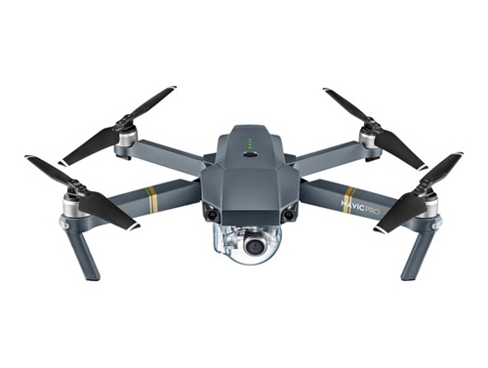
Why are we here?
Background of GAAP
“Precision Agriculture”
International market rights
Industry Situation
Leading technology
Rapidly-developing field
Question
How can GAAP be quickly launched into the most profitable market?
Choose Australia as our primary market
Notes:
Gyrfalcon Venture obtained a new technology called GAAP, which bring the concept of “Precision Agriculture” to farmers.
Once GAAP is installed on the drone, it can collect concise agricultural data for plants and soil, and potentially improve the yields through data analysis.
Since Gyrfalcon Venture controls the international market right of this platform, we are exploring globally to find an optimal market to launch this platform.
Currently GAAP is an advanced technology dominant agricultural data industry. Other competitors may not surpass this technology in 3-5 years.
So here come the question: how can we quickly launch GAAP into the market? We are aiming to maximize the profit within 3 years.
My team conducted a thorough research on the market and we would now explain why choose Australia as our primary market.
Hope we can bring you some new perspectives about Australia

Slide 3
Agenda
Why?
Introduce selection process
Demonstrate Australia’s advantages
How?
Finance Recommendation
Marketing Recommendation
Operation Recommendation
Next?
Suggestions for Launching Process

Slide 4
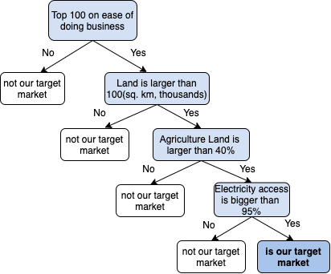
Selection Process
Narrow down choices to:
New Zealand
Australia
Germany
United Kingdom
United States
Spain
Turkey
Italy
Thailand
China
Mexico
Kazakhstan
Notes:
Initially we had 45 countries in the shortlist. Using the given data, we set some standards such as ease of doing business, area of both the entire country and arable land, and electricity access. Ten countries satisfied all the standards.

Slide 5
Further Research
New Zealand
Australia
Germany
United Kingdom
United States
Spain
Turkey
Italy
Thailand
China
Mexico
Kazakhstan
Adding following criteria:
Types of Crop
Rent Cost
Subsidy
Education Level
Agricultural Household Income
Agriculture Industrialization
👑
Australia
Notes:
To further filter and make one primary choice, we did amount of researches. For each country, we researched whether the plantation of their major agricultural products could be strongly supported by drones, whether the rent cost is reasonable for a short-term project, whether their government encourages technology upgrades in agriculture industry, and to what extent is the country developed and connected so that we can launch into the new market as quickly as possible, and avoid unnecessary costs. Australia is the winner after all filterings, and so it became our primary choice.

Slide 6

Key advantages
Fittable landscape
Large size and suitable geographic characteristics
Supportive basic infrastructure
Fully accessible to electricity and other key resources
Ease to launch business
Educated labor force
English is the official language
Affordability
Relatively high agriculture income
Notes:
Here are main advantages that allowed Australia to win throughout the entire filtering process. Australia has appropriate landscapes that allow effective usage of drones and sensors. It has developed basic infrastructures so that our target customers can make purchase decision without extra worries. And based on the general education and income level, we believe Australian people can accept and afford our product easily.

Slide 7
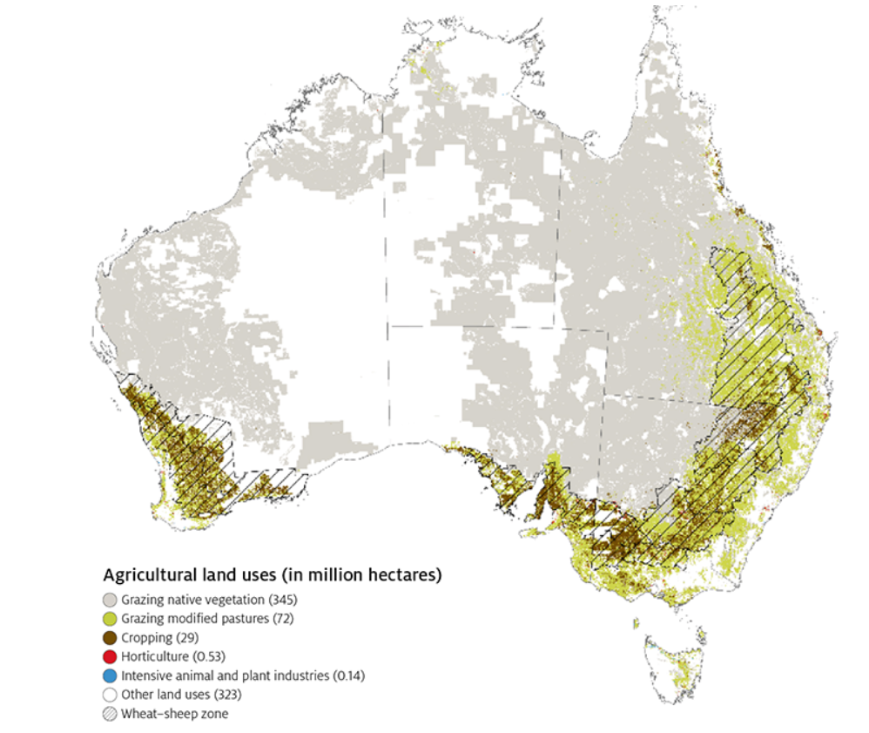
Geographic Advantage
Large arable land area
3,966,000 square kilometers
Concentrated flat plateau
Types of Crop
Wheat
Barley
Sorghum
Cottonseed
Canola
oats
Notes:
Appendix I
Noticeably, Australia has almost 4 million square kilometers of arable area. Main crops include wheat, barley, and sorghum, these crops are grown on flat plateaus. Arable lands are mostly concentrated at south part of Australia. We believe that such geographic characteristics will not only support effective usage of drones and sensors, but also guarantee that transportation and delivery of our product can be convenient. For the transportation part and further information, I’ll pass it to my team members.

Slide 8
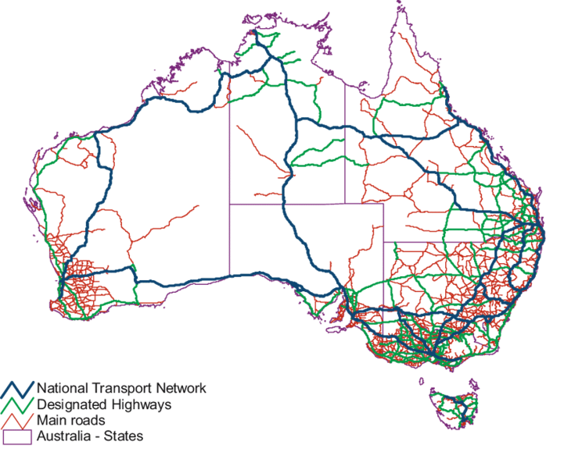
Supportive Infrastructures
Full access to necessary resources
100% electricity access guarantee the most basic requirement for drone market
Robust transportation system
823,000 km road in length
356,000 km paved road
36,064 km rail network
Notes:
Let’s move forward to the part of infrastructure, first, Australia is 100% electricity access which is a very basic requirement, if they want to use the product. Second, as you can see from the picture on the left side, this is the distribution of road network in Australia. It covers the main agricultural region in Australia, the company can reach as many as possible potential customers. Also, because of the complete road network and rail network, The shipping cost within Australia is relatively cheap. And the shipping method will be flexible.

Slide 9
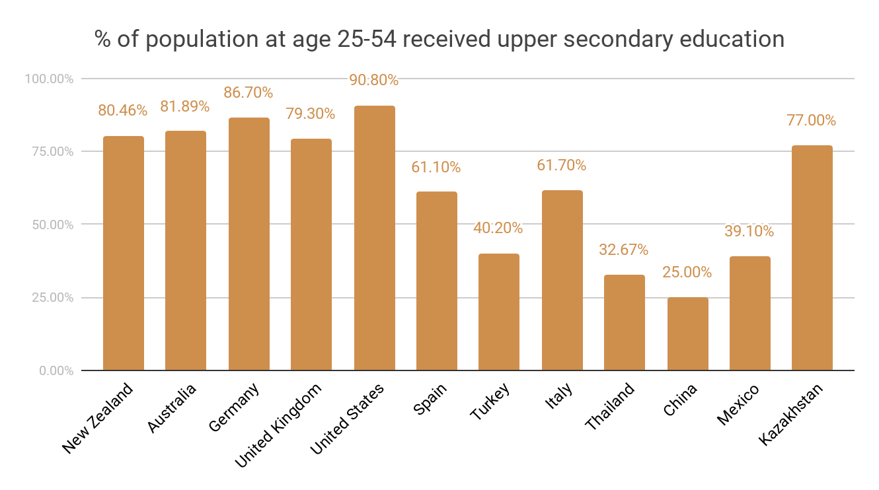
Human Resource
Training Cost
Higher education might leads to higher productivity
Salary
The average salary in Australia is $ 53,300 per year
Notes:
Appendix III
Another advantage of Austria is that more than 80% of Australians who is between 25-54 years old accept upper secondary education. Local employee can learn quickly and there is no language barrier, No much cost on skill training and language training. you can communicate with them very well, then easy to control. At the same time, The average wage in Australia is only 53.3 thousands per year. Compare with U.S.A’ average wage, which is 63.3 thousands per year. It is much cheaper.

Slide 10
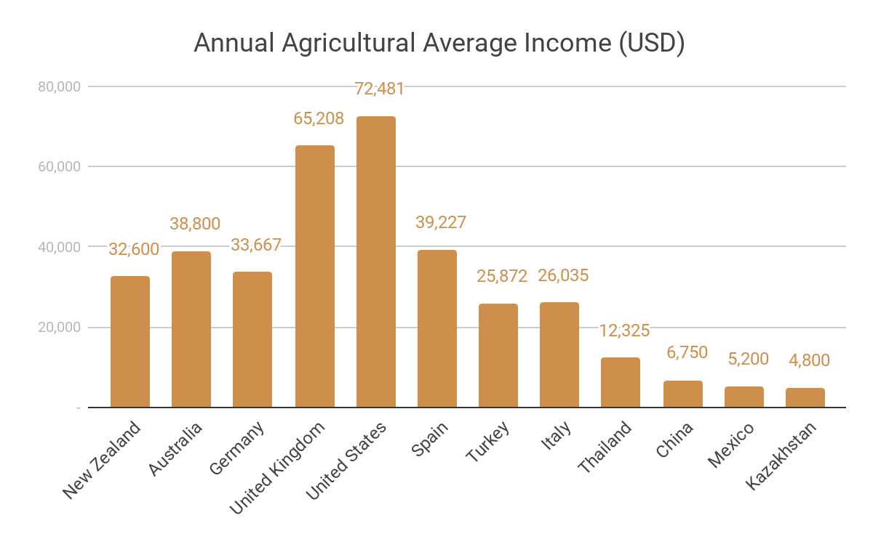
Affordability for Farmers
Income
Consider the affordability of agriculture drones for farmers by their income level
Annual agricultural average income in Australia is $38,800
Developing countries have lower business operation cost, but drones may not be affordable for farmers
Notes:
Based on our research, the annual agricultural average income is $ 38,800 us dollar per year. In general, there are lot of farms a family own, it means the total income of farm is about $150,000 us dollar. So, we think they definitely afford the product.

Slide 11
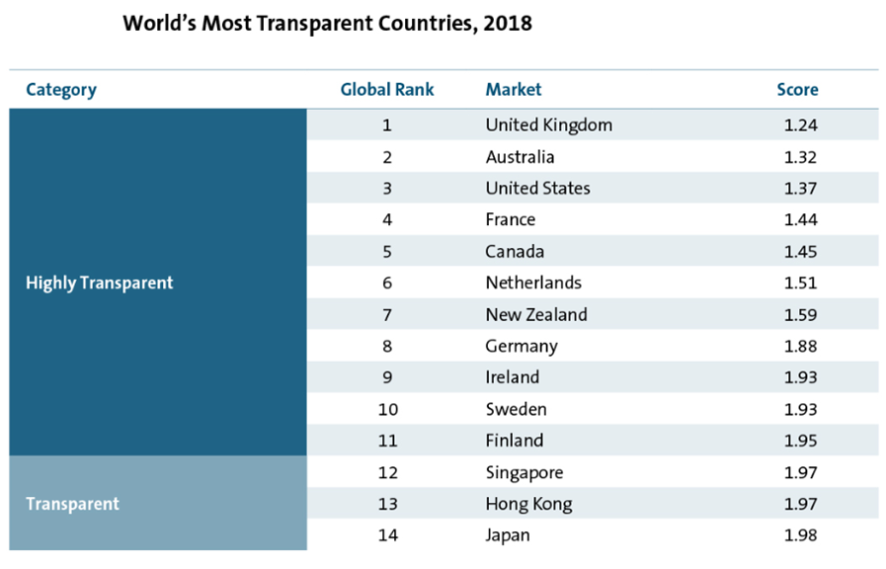
Business environment
High ranking on ease of doing business
Top 20 out of 190 economies
Takes minimum 2.5 days to start a business
5th position on enforcing contracts
Market transparency
Second most transparent market among the world
High corruption perceptions index: 8.1
Efficient regulation
Sound intellectual protection properties
Encourage agricultural technology upgrade
25% tax reduction for new agricultural machinery
World’s Most Transparent Countries, 2018
Notes:
---5.6 days for US, 8.6days for China---world bank
Enforcing contract - Grantee cashflow
With all those combined, speed up the process of launching
---Reliable market,
Transparent- accurate data and feedback from the market
--Data from WFE Global Competitiveness Report
---even though no competitor in existing market --australian trade and investment commision
Complete training policy
Expect that farmer high acceptance of our product
25% tax reduction for new agricultural machinery--foreign agriculture farmer
Corruption perceptions index relates to perceptions of the degree of corruption as seen by business people and country analysts, and ranges between 10 (highly clean) and 0 (highly corrupt). It is a composite index, making use of surveys of business people and assessments by country analysts. It consists of credible sources using diverse sampling frames and different methodologies. These perceptions enhance our understanding of real levels of corruption from one country to another.

Slide 12
Agenda
Why?
Introduce selection process
Demonstrate Australia’s advantages
How?
Finance Recommendation
Marketing Recommendation
Operation Recommendation
Next?
Suggestions for Launching Process

Slide 13
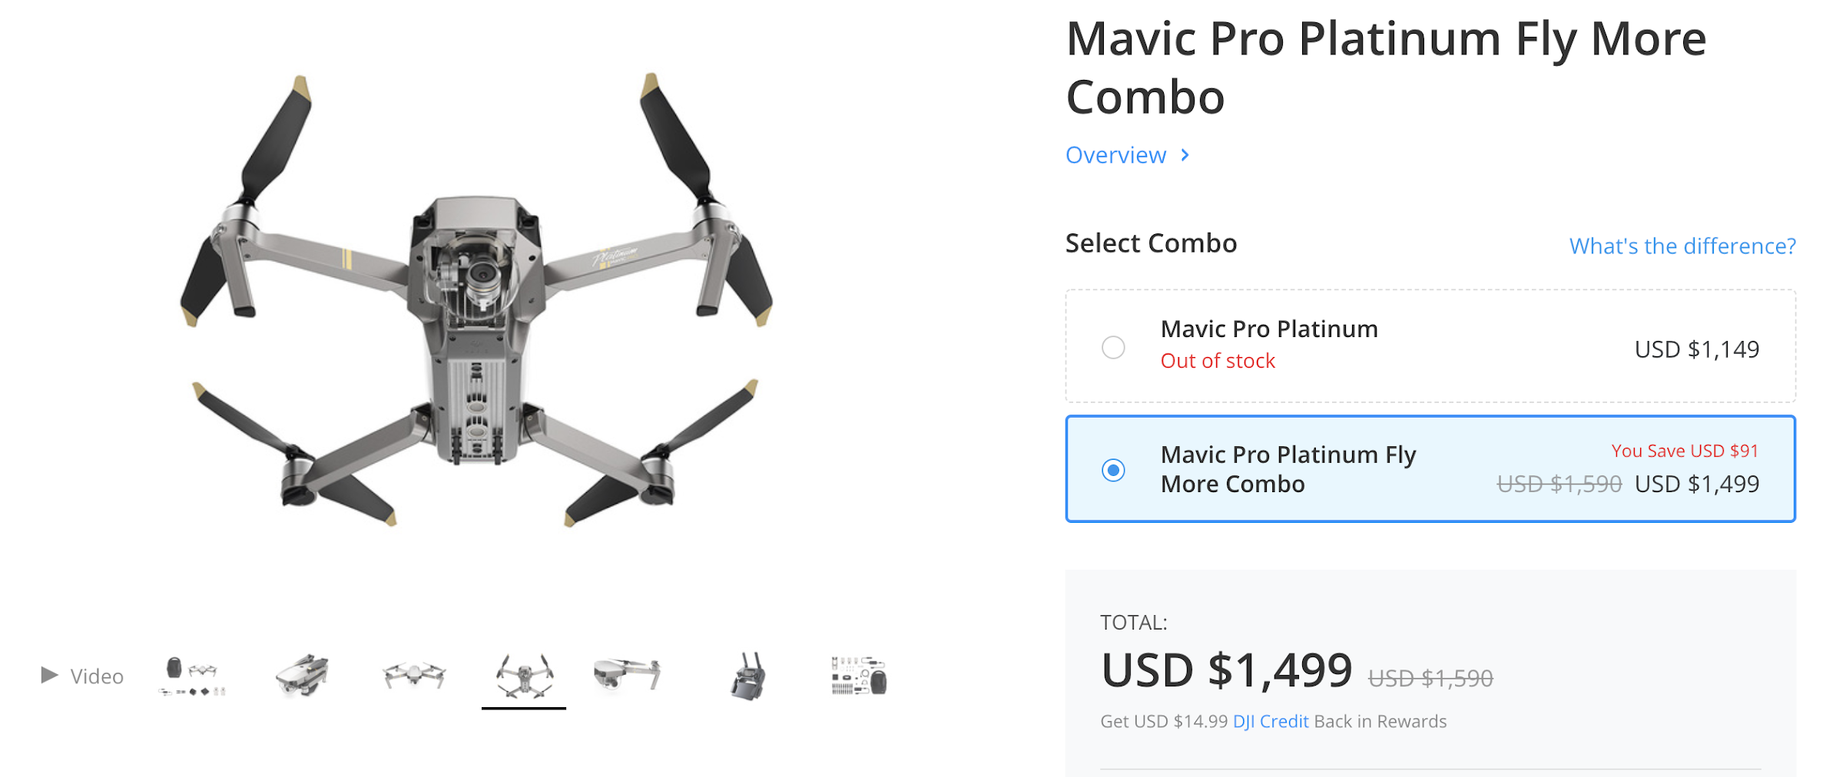
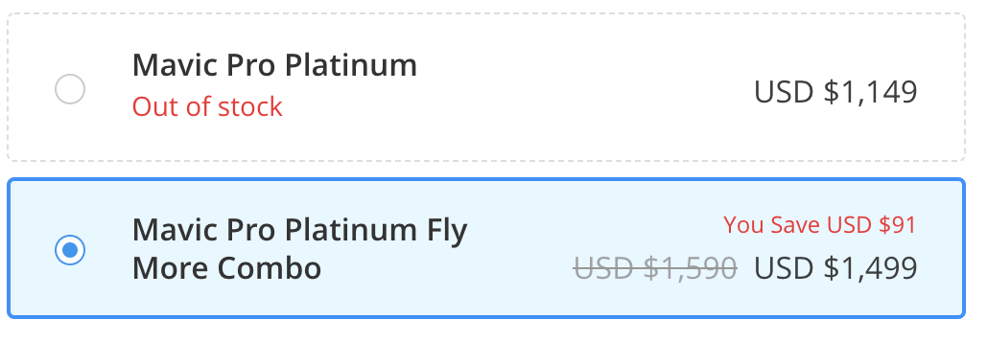
Finance Recommendation
Suggested retail price: $449.99 per unit
The most popular quad-copter drone in Australia is Dji Mavic Pro model
Mavic Pro’s accessories price is around $400
Notes:
Base on the market research, the suggested retail price is $449.99
Optional accessories for mavic pro is priced around 400 dollars
We are not selling the drone.
The most popular drone in Australia is Dji Mavic Pro

Slide 14



Finance Recommendation
Shipping cost
Offer free international shipping service for all customers
Partner with delivery courier to keep the shipping cost under 10% of the total revenue
Potential shipping partners: DHL, STARTRACK, AustraliaPost,

Slide 15
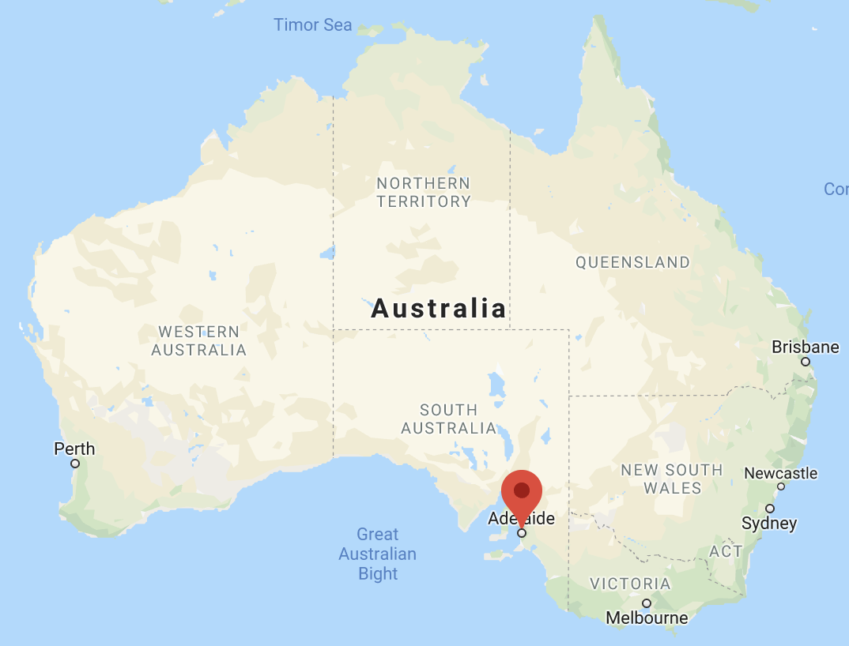
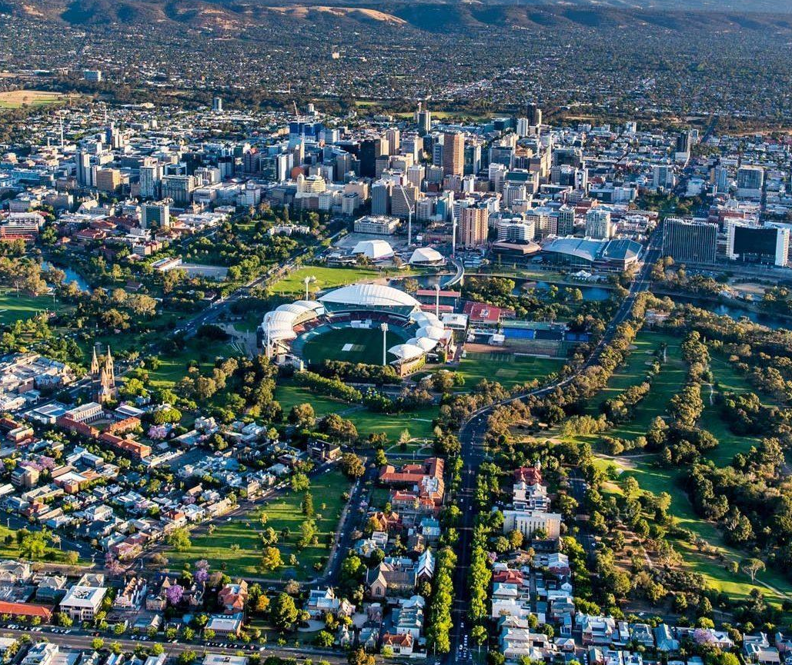
Finance Recommendation
Fixed cost
Recommend office location: Adelaide downtown area
Annual renting cost for a 450 square meter office is $227,550
Notes:
Adelaide is the ideal location for business investment, combining low business costs, a high quality of life, strong local manufacture industry.
Comparing to Sydney, Melbourne, Adelaide commercial property price is lowest, and labor cost is also 10% lower than the industry average
Adelaide is also the centre of the nation’s air, road and rail logistics networks, which offer efficient connections to the whole country

Slide 16
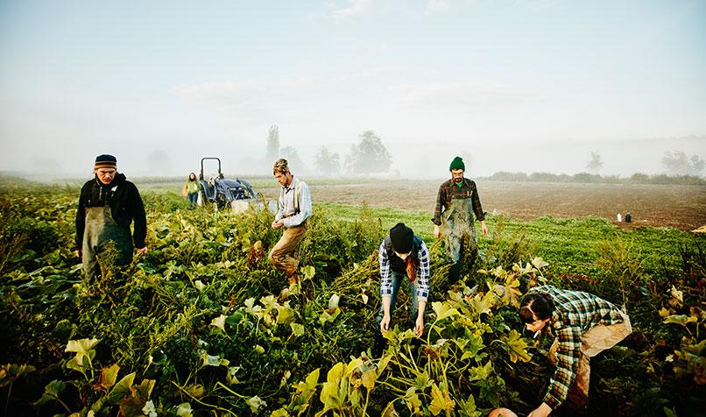
Marketing Recommendation
Market size
Australian farmers and graziers own 135,997 farms
Approximately 85,483 agricultural businesses have an Estimated Value of Agricultural Operations (EVAO) of $40,000 or greater
Target customer
Average age for agriculture workers in Australia is 49 years old
75% of the agriculture workers are above 25 years old

Slide 17

Marketing Recommendation
Suggest Marketing method
Combining both traditional marketing and digital marketing method
Radio: Fiver times per day, seven days a week
Newspaper: One time per week
Television: One time per day
Google Ads
With an emphasis on the traditional marketing method

Slide 18




Marketing Recommendation
Radio
：$3,500 / week
Newspaper
: $5,000 / time
Television
：$500 / time
Google Ads
：$20,000/ month
Estimated Advertising Cost For First Month:
$82,000
Estimated Advertising Cost For First Year:
5% of the Total Revenue
Notes:
Here are some estimated price for different marketing methods

Slide 19
Operation Recommendation
Technology Support
Build up online customer service system
Phone call or video guidance for software installation
Administrative Team
Hire about 50 people
80% of team members are hired from local
20% of team members are staff and managers from Gyrfalcon Venture

Slide 20
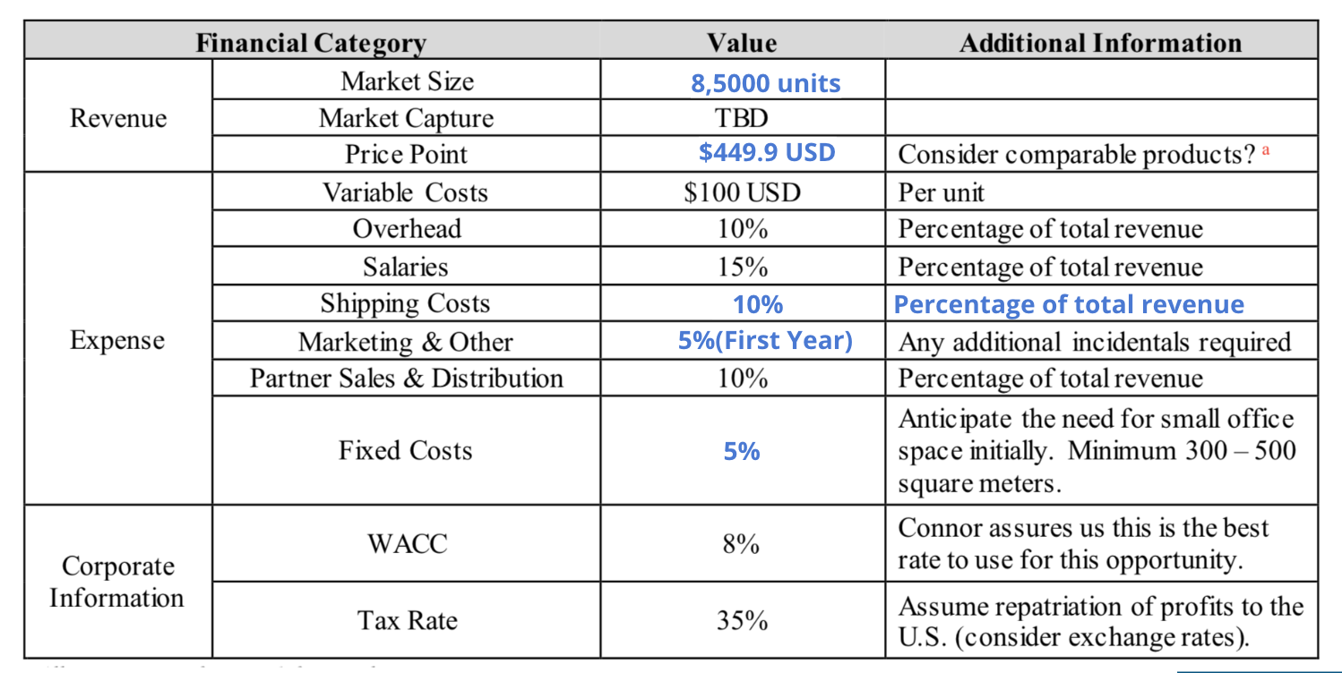
Analysis Summary
85,000 units

Slide 21
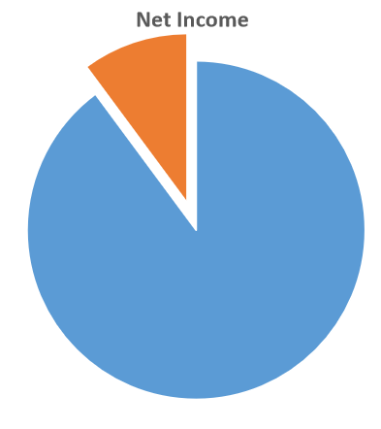
Analysis Summary
Profit estimate per unit
With sale price $449.99, the estimated profit is $43.2 per unit
Three years total profit
Estimated $3,690,000 net profit in three years
Proportion of net income
GAAP will bring 10.15% net income increase for Gyrfalcon Venture
GAAP Business
10.15%
Other Gyrfalcon business

Slide 22
Agenda
Why?
Introduce selection process
Demonstrate Australia’s advantages
How?
Finance Recommendation
Marketing Recommendation
Operation Recommendation
Next?
Suggestions for Launching Process

Slide 23


Expedite the Launching Process
Promotion and advertising
Product testing and soft launch
Press release to media
Educational program and experience program
Notes:
Script
To launch our product successfully and quickly, we will need to follow these regular steps. For promotion we may partner with drone manufacturer to provide bundles. But there are more things we should do.
As we know, more expensive farming equipments often rely on sales representative as such investments can be hard-to-make decisions for farmers alone, and huge machines are often complex to maintain and utilise. Even our products are much simpler and cheaper, people won’t feel comfortable buying the system by looking at fictional picture of them spraying chemicals as you would for something with established reputation such as Dyson. So we need to allow people hands-on experience and build up our momentum of marketing.
Our biggest obstacle is to overcome unfamiliarity.
For that reason, we need to form good relationship with farmers association, for example National Farmers Federation, which is the largest in Australia. And to make our presence at local agriculture expo, for example AgQuip, which is Australia’s biggest field days and one of the largest agri-events in the world. As you may not know, a field day is a large trade show for agricultural industry and equipment. Through efforts at various scale and channel, we would be able to launch successfully.
After launch, what is important is the feedback and improvements. As you can see these are some of the steps we will be experiencing. I won’ t go into detail since they are highly related to the actual situations and specific reception. The point I want to emphasise is that although we won’t invest significant R&D in this technology, we are still open to small technical alterations and customisations. Australia is a vast continent with a wide variety of climates, plants and soil differ, and so as the type of water, chemicals, or fertiliser that farmers want to apply. Thus we may adjust our platform components accordingly and introduce new functions.
The market potential is huge! We have made comprehensive research and given you our most confident and sincere recommendations. Whatever you may decide considering all other factors, we will be willing to offer followup consultancy and further research if needed. Thank you for your time!
Next is our Q&A session.

Slide 24

Feedback and Improvements
Receive feedbacks from sales team and customers
Adjust sales strategy
Small technical improvements
Customer retention
Notes:
Script
To launch our product successfully and quickly, we will need to follow these regular steps. But there are more things we should do.
As we know, more expensive farming equipments often rely on sales representative as such investments can be hard-to-make decisions for farmers alone, and huge machines are often complex to maintain and utilise. Even our products are much simpler and cheaper, people won’t feel comfortable buying the system by looking at fictional picture of them spraying chemicals as you would for something with established reputation such as Dyson. So we need to allow people hands-on experience and build up our momentum of marketing.
Our biggest obstacle is to overcome unfamiliarity.
For that reason, we need to form good relationship with farmers association, for example National Farmers Federation, which is the largest in Australia. And to make our presence at local agriculture expo, for example AgQuip, which is Australia’s biggest field days and one of the largest agri-events in the world. As you may not know, a field day is a large trade show for agricultural industry and equipment. Through efforts at various scale and channel, we would be able to launch successfully.
After launch, what is important is the feedback and improvements. As you can see these are some of the steps we will be experiencing. I won’ t go into detail since they are highly related to the actual situations and specific reception. The point I want to emphasise is that although we won’t invest significant R&D in this technology, we are still open to small technical alterations and customisations. Australia is a vast continent with a wide variety of climates, plants and soil differ, and so as the type of water, chemicals, or fertiliser that farmers want to apply. Thus we may adjust our platform components accordingly and introduce new functions.
The market potential is huge! We have made comprehensive research and given you our most confident and sincere recommendations. Whatever you may decide considering all other factors, we will be willing to offer followup consultancy and further research if needed. Thank you for your time!
Next is our Q&A session.

Slide 25
Thank you for your time!

Slide 26
Q&A Session

Slide 27
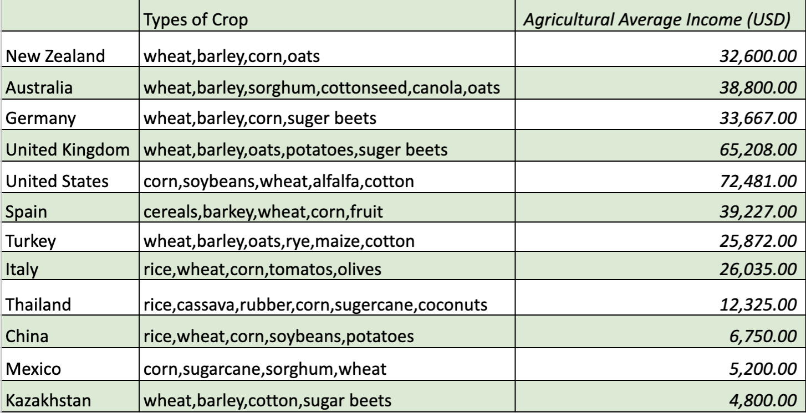
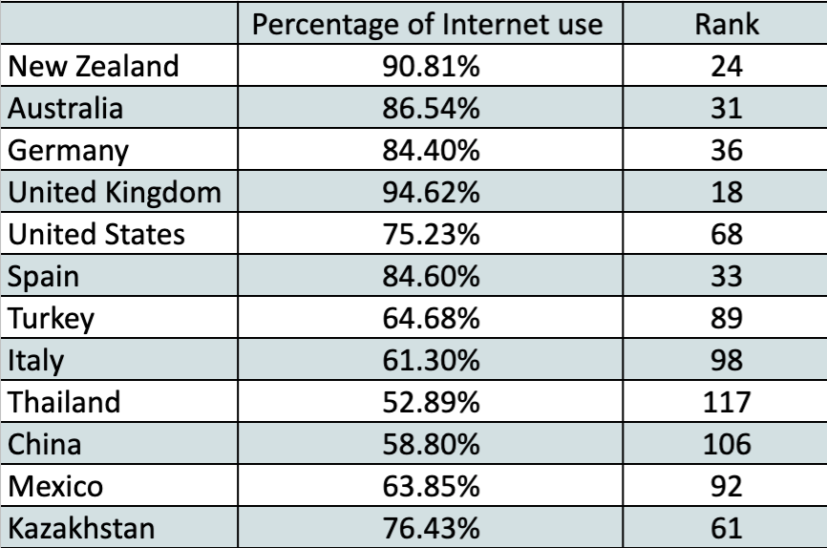
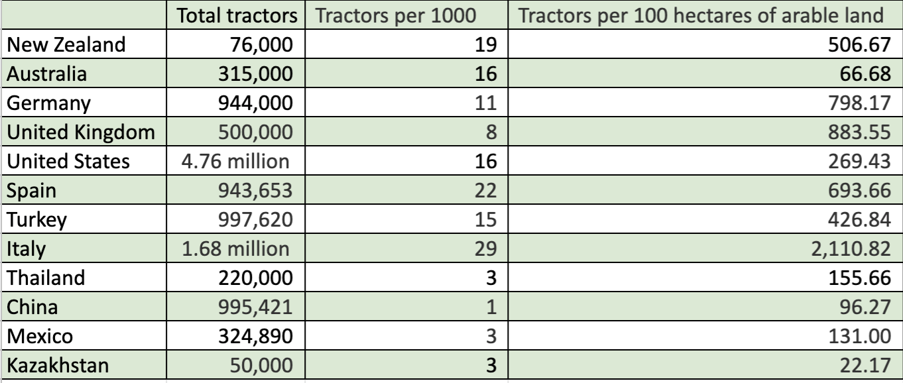
Appendix I

Slide 28
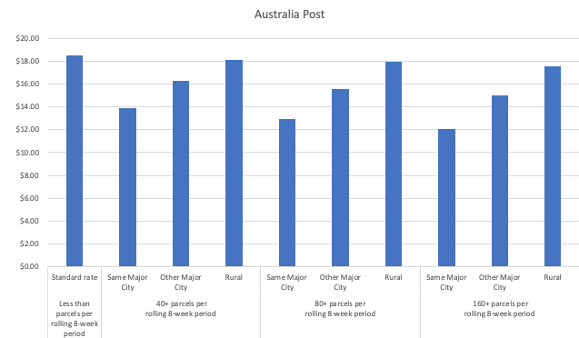
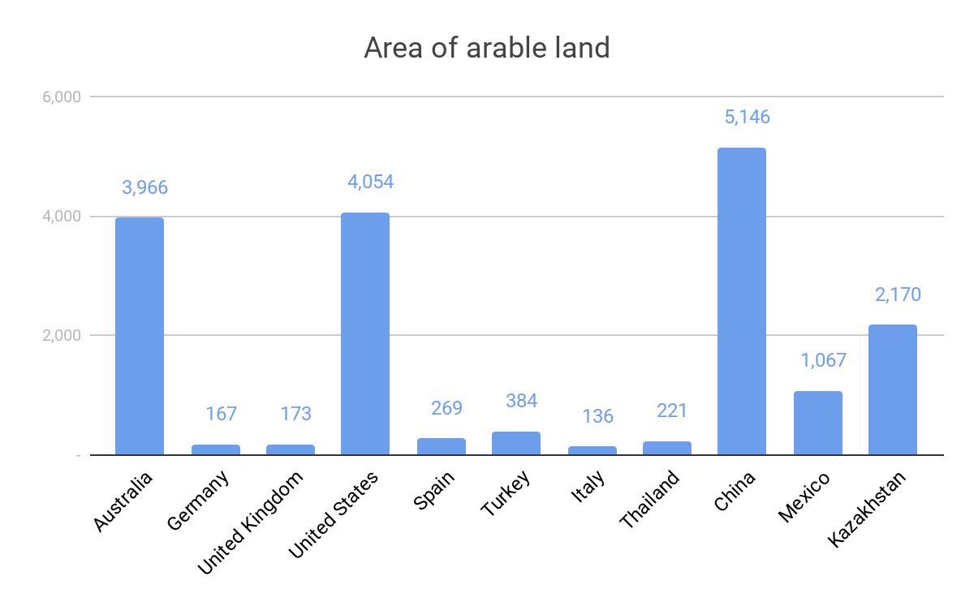
Appendix II
#1 in
Inflation, Annual% Change
#1 in
Complexity of Tariff
#1 in
Social Capital
#4 in
Soundness of Banking
#4 in
Debt Dynamics
#5 in
E-participation
#7 in
Efficiency of the Clearance Process
#7 in
Judicial Independence

Slide 29
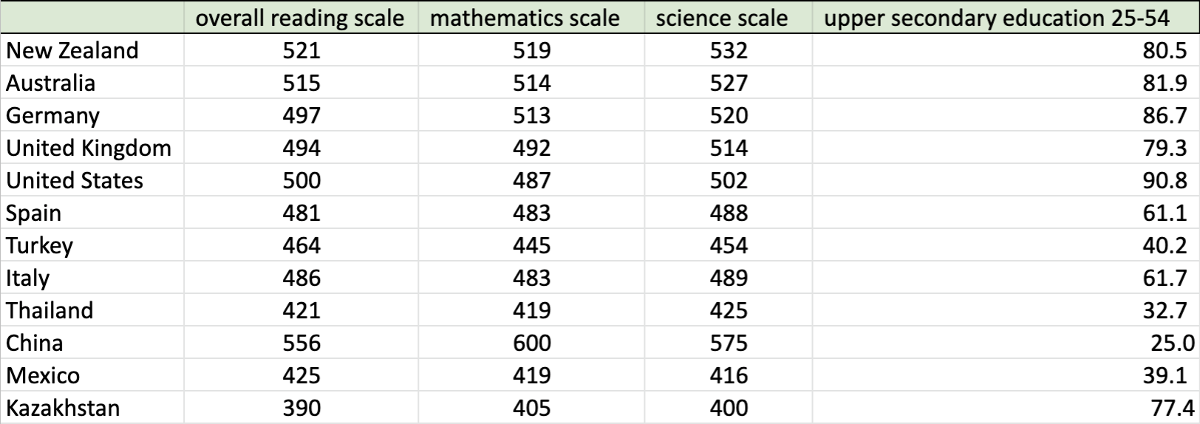
Appendix III
Education level among 25-52 year-old

Slide 30
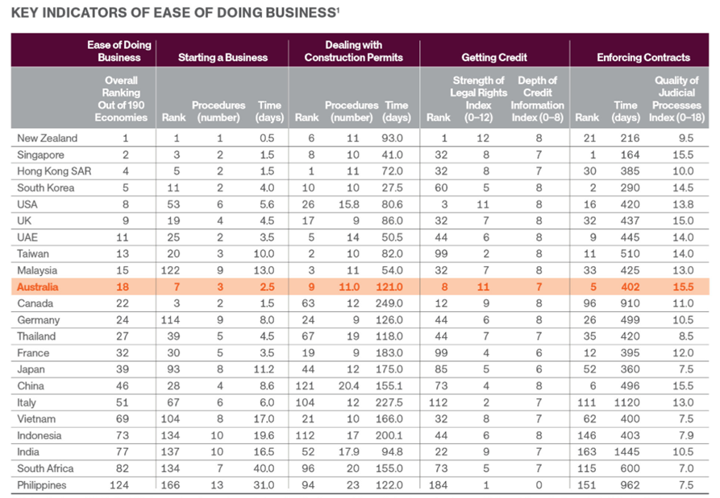
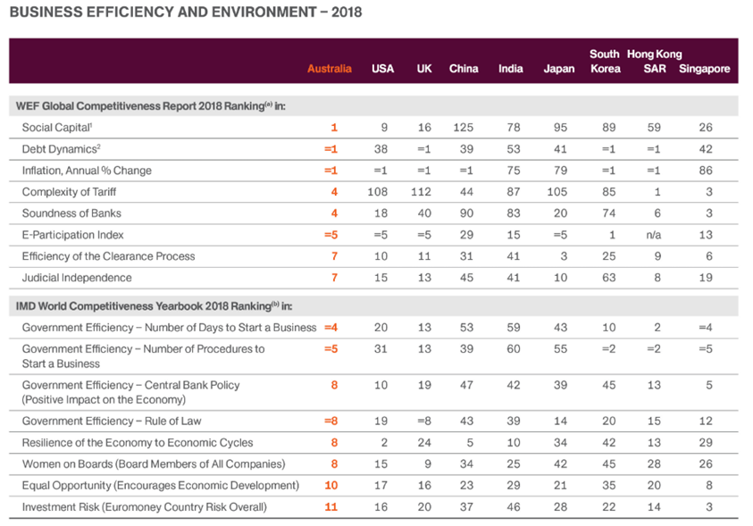
Appendix IV
Notes:
5.6 days for US, 4.5days for UK. 8.6days for China

Slide 31
Appendix V
Financial part computation logistic
Price estimation : $449.99
E.g. Most popular Dji Mavic Pro is $1000 usd, accessories’ price is $400
Fix cost:
Office Rent: Adelaide downtown: $300 per square meter per year (cheaper than renting in Sydney, Melbourn). We assume rent fee is 227550$ per year
Product cost: $100
Shipping cost: Free shipping for customer, negotiate with delivery company to control the shipping cost per unit under $50 10% of the total revenue
Profit estimate per unit: (449.99*(1-0.63)-100)*(1-0.35) = 43.2
Market size: In Australia, farmers and graziers own 135,997 farms. There are approximately 85,483 agricultural businesses in Australia that have an Estimated Value of Agricultural Operations (EVAO) of $40,000 or greater (as of June 2018), which are our target customers.
Estimate profits for three years: 43.2*85483 = 3,690,000

Slide 32
Appendix VI
The Global Competitiveness Report: http://reports.weforum.org/global-competitiveness-index-2017-2018/
---Global Competitiveness Index: http://reports.weforum.org/global-competitiveness-index-2017-2018/competitiveness-rankings/
---Soundness of Banks: http://reports.weforum.org/global-competitiveness-index-2017-2018/competitiveness-rankings/#series=EOSQ087
OECD Data: https://data.oecd.org/
---Unit Labour Cost Level Change: https://data.oecd.org/lprdty/unit-labour-costs.htm
---Unit Labour Cost: https://stats.oecd.org/Index.aspx?DataSetCode=PDBI_I4 Productivity Archives - Unit Labour Costs - Annual Indicators - Labour Compensation per Employee/Hour ($US PPP adjusted)
BMI Research: Australia Business Forecast Report: https://libguides.gwu.edu/businessdatabases - Business Source Ultimate
The Benefits of a Well-Educated Workforce: https://cumberlandbusiness.com/news/well-educated-workforce/
Transportation System: https://www.roadtraffic-technology.com/features/featurethe-worlds-biggest-road-networks-4159235/
Business Environment Ranking:https://www.tourisminvestment.com.au/en/why-australia/easy-place-to-do-business.html
- Data from WFE Global Competitiveness Report

